Slide 1
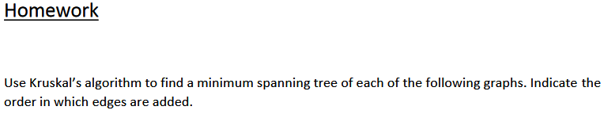
Group Name: Error 404
Group Leader: Mark Decello
Group Members: Mark Decello, Julius Lopez, Gene Olivia, Hanel Duran, Naglaa Saeid
Graph 1……………………………………………………………..Page 1
Graph 2……………………………………………………………..Page 2
Graph 3……………………………………………………………..Page 3
Graph 4……………………………………………………………..Page 4

Slide 2
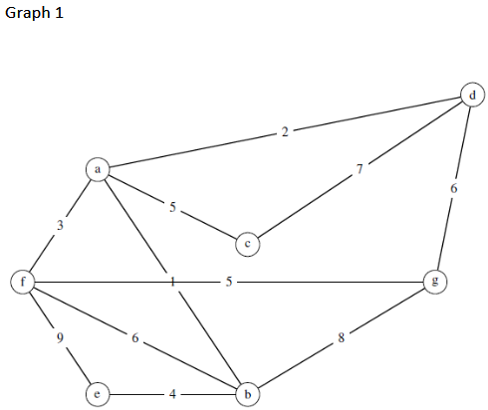
Page 1
2
d
a
5
3
c
1
f
5
g
4
e
b
1 + 2 + 3 + 4 + 5 + 5 = 20
Edges | Weights | Rankings |  | Added? | {a}, {b}, {c}, {d}, {e}, {f}, {g}
[ab] | 1 | [ab] | 1 | yes | {a, b}, {b}, {c}, {d}, {e}, {f}, {g}
[ac] | 5 | [ad] | 2 | yes | {a, b, d}, {c}, {e}, {f}, {g}
[ad] | 2 | [af] | 3 | yes | {a, b, d, f}, {c}, {e}, {g}
[af] | 3 | [be] | 4 | yes | {a, b, d, e, f}, {c}, {g}
[be] | 4 | [ac] | 5 | yes | {a, b, c, d, e, f}, {g}
[bf] | 6 | [fg] | 5 | yes | {a, b, c, d, e, f, g}
[bg] | 8 | [bf] | 6 | no
[cd] | 7 | [dg] | 6 | no
[dg] | 6 | [cd] | 7 | no
[ef] | 9 | [bg] | 8 | no
[fg] | 5 | [ef] | 9 | no

Slide 3
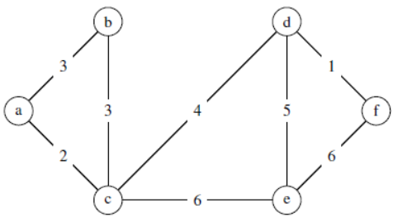
Page 2
b
d
3
1
a
4
f
5
2
c
e
1 + 2 + 3 + 4 + 5 = 15
Edges | Weights | Rankings |  | Added? | {a}, {b}, {c}, {d}, {e}, {f}
[ab] | 3 | [df] | 1 | yes | {a}, {b}, {c}, {d, f}, {e}
[ac] | 2 | [ac] | 2 | yes | {a, c}, {b}, {d, f}, {e}
[bc] | 3 | [ab] | 3 | yes | {a, b, c}, {d, f}, {e}
[cd] | 4 | [bc] | 3 | no | {a, b, c}, {d, f}, {e}
[ce] | 6 | [cd] | 4 | yes | {a, b, c, d, f}, {e}
[de] | 5 | [de] | 5 | yes | {a, b, c, d, f, e}
[df] | 1 | [ce] | 6 | no
[ef] | 6 | [ef] | 6 | no

Slide 4
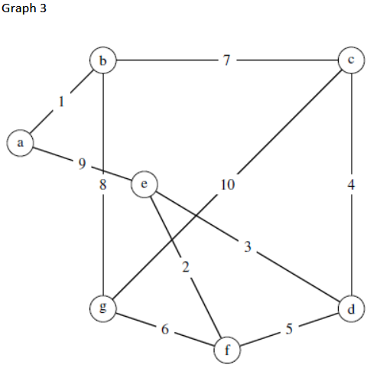
Page 3
7
1
b
c
a
e
4
3
2
g
d
6
f
1 + 2 + 3 + 4+ 6 + 7 = 23
Edges | Weights | Rankings |  | Added? | {a}, {b}, {c}, {d}, {e}, {f}, {g}
[ab] | 1 | [ab] | 1 | yes | {a, b}, {c}, {d}, {e}, {f}, {g}
[ae] | 9 | [ef] | 2 | yes | {a, b}, {c}, {d}, {e, f}, {g}
[bc] | 7 | [de] | 3 | yes | {a, b}, {c}, {d, e, f}, {g}
[bg] | 8 | [cd] | 4 | yes | {a, b}, {c, d, e, f}, {g}
[cd] | 4 | [df] | 5 | no | {a, b}, {c, d, e, f}, {g}
[cg] | 10 | [fg] | 6 | yes | {a, b}, {c, d, e, f, g}
[de] | 3 | [bc] | 7 | yes | {a, b, c, d, e, f, g}
[df] | 5 | [bg] | 8 | no
[ef] | 2 | [ae] | 9 | no
[fg] | 6 | [cg] | 10 | no

Slide 5
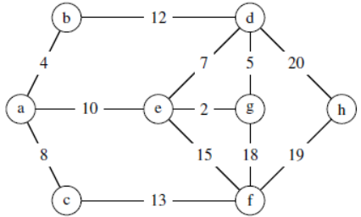
Page 4
b
d
4
5
10
2
a
e
g
h
8
19
13
c
f
2 + 4 + 5 + 8 + 10 + 13 + 19 = 61
Edges | Weights | Rankings |  | Added? | {a}, {b}, {c}, {d}, {e}, {f}, {g}, {h}
[ab] | 4 | [eg] | 2 | yes | {a}, {b}, {c}, {d}, {e, g}, {f}, {h}
[ac] | 8 | [ab] | 4 | yes | {a, b}, {c}, {d}, {e, g}, {f}, {h}
[ae] | 10 | [dg] | 5 | yes | {a, b}, {c}, {d, e, g}, {f}, {h}
[bd] | 12 | [de] | 7 | no | {a, b}, {c}, {d, e, g}, {f}, {h}
[cf] | 13 | [ac] | 8 | yes | {a, b, c}, {d, e, g}, {f}, {h}
[de] | 7 | [ae] | 10 | yes | {a, b, c, d, e, g}, {f}, {h}
[dg] | 5 | [bd] | 12 | no | {a, b, c, d, e, g}, {f}, {h}
[dh] | 20 | [cf] | 13 | yes | {a, b, c, d, e, f, g}, {h}
[ef] | 15 | [ef] | 15 | no | {a, b, c, d, e, f, g}, {h}
[eg] | 2 | [fg] | 18 | no | {a, b, c, d, e, f, g}, {h}
[fg] | 18 | [fh] | 19 | yes | {a, b, c, d, e, f, g, h}
[fh] | 19 | [dh] | 20 | no

